Slide 1

National Road Safety Intelligence Bureau

Slide 2
About National Road Safety Intelligence Bureau
Our Story
Mission
Philosophy
Services
Key Achievements

Slide 3

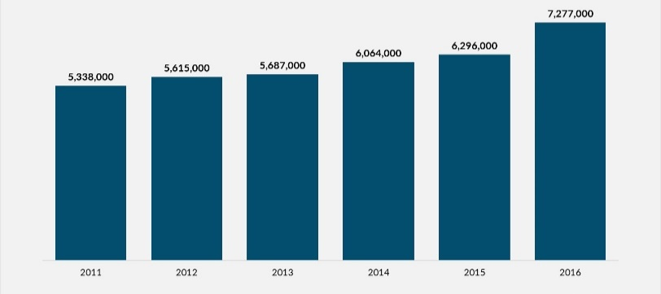
Our Story
2011 - 2016
Escalating surge in road accidents and the alarming yearly statistics
Collaborative venture with the Department of Transportation
To delve into the extensive data surrounding major road accidents, deciphering patterns and trends to devise effective solutions.
By establishing a company dedicated to addressing recurring road accidents and tackling road safety challenges, we aimed to leverage available data efficiently.
To combine road accident knowledge with cutting-edge technology.
To develop innovative solutions for significantly reducing casualties on the roads.

Slide 4

Mission
The bureau is dedicated to a primary mission: raising awareness about road safety with the ultimate goal of reducing the number of accidents.
Our office is committed to addressing road safety concerns in collaboration with transportation authorities, law enforcement agencies, and other key stakeholders. Our collective aim is to enhance safety measures and mitigate the tragic consequences of road accidents.

Slide 5

Philosophy
"In the journey of life, the road to safety is paved with collective mindfulness, where every step forward is a commitment to protect and preserve the precious moments that lie ahead."

Slide 6
Our Analysis
Let’s Look at Our Dashboard

Slide 7
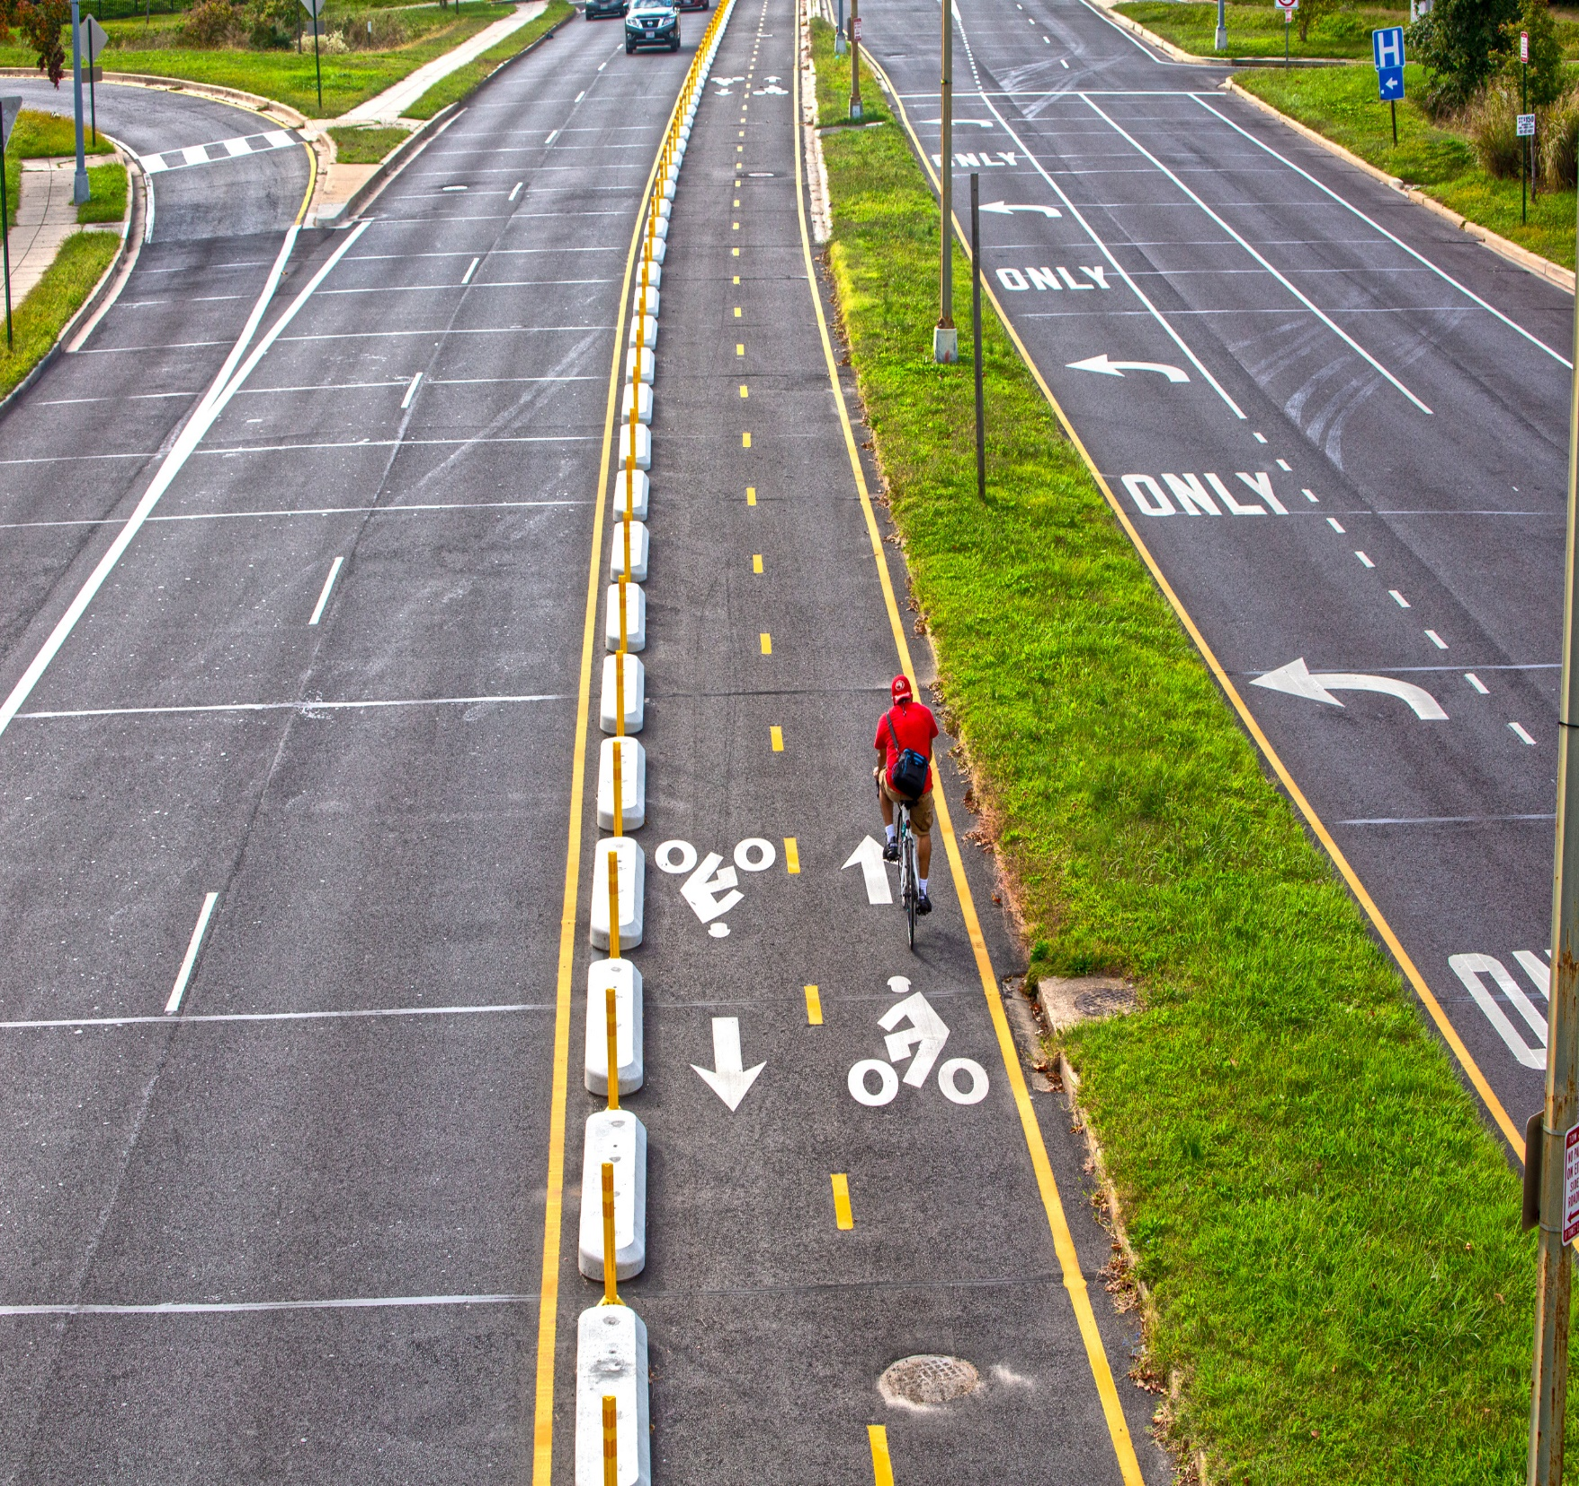
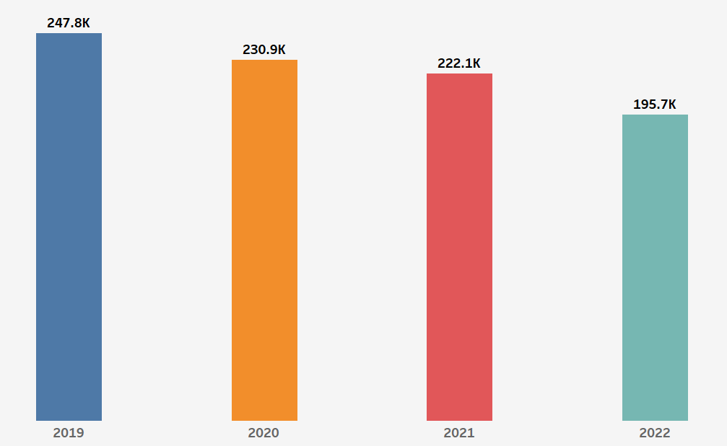
Achievements
Diligent analysis and strategic interventions as business analysts
dissected the data
identified critical patterns and trends
Translated these insights into targeted measures and collaborative initiatives
Significant decrease in casualties

Slide 8
Our Services
Awareness & Information
Towing services
Medical Assistance

Slide 9
Our Vision
Public awareness and educational programs
Campaigns on causal factors
Billboards on accident facts
Billboards on traffic rules
Collaborative awareness programs with telecommunication companies
Data collection and continuous descriptive and predictive analysis
Data Quality assurance and regular data validation

Slide 10
Our Vision – Cont.
Integrate the data into a mobile application, using the longitude and latitude coordinates of accident locations
Real-time incident reporting and response system
Utilize technology, such as intelligent transportation systems, to manage traffic flow and enhance road safety
An efficient management of accident scenes without causing extended road closures.
Use geospatial analysis to identify high-risk areas
Effective communication systems with the user through advanced automated reporting and alert systems
Advanced security measures for data protection

Slide 11
Thank you
Questions?

